Slide 1
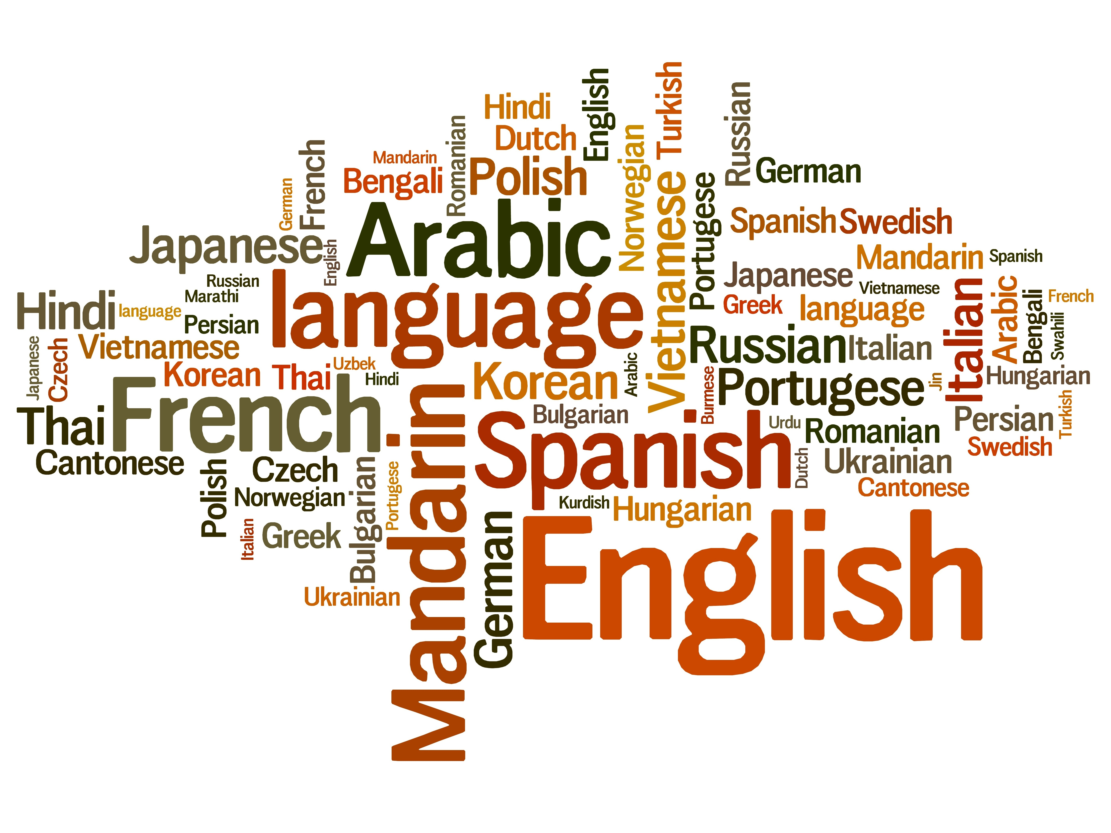
Dive Deeper into Present-Day English
Vol.1 -What English Is-
Composed By: Hayato Ishida
For Japanese version, click here
Updated On: 16 July 2024

Slide 2

About Me
Accounts
GitHub: @hayat01sh1da
X: @hayat01sh1da
LinkedIn: @hayat01sh1da
Speaker Deck: @hayat01sh1da
Docswell: @hayat01sh1da
Occupation: Software Engineer
Things I Am Into
Linguistics
Singing at Karaoke
Listening to Music
Watching Movies
Cat Feeding

Slide 3
Licences / Certifications
English
TOEIC® Listening & Reading 915: Certified on December 2019
Engineering
Information Security Management: Certified on November 2017
Applied Information Technology Engineer: Certified on June 2017
Fundamental Information Technology Engineer: Certified on November 2016
IT Passport: Certified on April 2016
Others
Abacus 2nd Class: Certified on June 2002
Mental Arithmetic 3rd Class: Certified on February 2001

Slide 4
Skill Stack
Languages
Japanese: Native Proficiency
English: Full professional Proficiency
Development
Backend: Ruby(Ruby on Rails), Python
Frontend: TypeScript + React.js, TypeScript +Vue.js
Database: MySQL, PostgreSQL, MongoDB
Architecture: Monolith, Modular Monolith
Hosting: AWS ESK
Versioning: Git, GitHub
CI/CD: GitHub Actions, ArgoCD
Monitoring: Datadog, Sentry

Slide 5
Work Histories
Period | Genre | Position | Jobs
Aug 2021 - Present | Saas(Educational Service) | Software Engineer | Backend Development Frontend Development CI/CD Maintenance Weekly Release Manager Troubleshooting Documentation Technical Debt Resolution Tech Blog Entries LT Speaker
Feb 2020 - Dec 2020 | SaaS(Chatbot Platform) | Backend Engineer | Backend Development Documentation Technical Debt Resolution Inspection of Alternative API

Slide 6
Work Histories
Period | Genre | Position | Jobs
Jun 2018 - Jan 2020 | Contract-basis Developer | Software Engineer | Backend Development Frontend Development Troubleshooting Quality Assurance Tech Blog Entries
Apr 2016 - Jan 2018 | System Engineering Service | System Engineer | Corporate Account Admin Windows Server Maintenance Security Admin Assistant Internationalisation / Localisation

Slide 7
International-Exchange Activities
Activities in University
English Linguistics Seminar(Focusing on Mass Media English)
International-Exchange Clubs(The 2nd Year)
International-Exchange Programmes conducted by Japan Cabinet Office(2013 - 2016)
Japanese Linguistics Course(The Final Year)
Overseas Life Experience
Working Holiday in Australia(April 2014 - March 2015)
Language School for 1 month in Sydney
Work for 6 Months in Hamilton Island Resort
Volunteering for 1 Month as Assistant Teacher of Japanese Language at St Ives High School in NSW
Other Activities
Keep Everyday Journal in English (April 2014 - Present)
Sunrise Toastmasters Club(February 2017 - March 2018)
Vital Japan(January 2018 - July 2019, October 2022 - February 2023)
Self Learning and Training of English Language
Participation Ruby-Related Tech Conferences

Slide 8
Goals of This Series
To know how deep English Language is
Not simply a communication tool
To know your own language by knowing another
"He who knows no foreign languages knows nothing of his own." by Johann Wolfgang von Goethe
To pursue the essence that does not instantly but work later on
Something which you think is meaningless has something genuine

Slide 9
Agenda
Periods of English Language
Relation between Language Families and Learning Costs
Specific Features of Present-Day English
Summary
References

Slide 10
1. Periods of English Language

Slide 11
1. Periods of English Language
Periods | Eras | Linguistically and Historically Important Events
Proto-Indo- European → Proto-Germanic | B.C. 1000 - A.D. 400 | Grimm's Law(The 1st Consonants Shift) Organised sound changes were made in some consonants e.g., /p/ → /f/, /t/ → /p/, /k/ → /h/, /kw/ → /hw/
Old English | 500 - 1100 | Vikings Conquest of English Creation of Dane Law in the late 9th Century Dominance by the Dane from the early to middle 11th Century Absorption of Old Norse Words into English via Language Conflicts
Middle English | 1100 - 1500 | Norman Conquest French as the Official Language in England(Spoken by the Rulers) English as an unofficial Language in England(Spoken by the Ruled) Absorption of French Words into English via Language Conflicts
Modern English | 1500 - 1800 | Great Vowel Shift: Long Vowels to Double Vowels(e.g., name) Increased Loan Words: Via active trades in the Age of Discovery
Present-Day English | 1800 - Present | Development of IT and Mass Media: Emergence of New Vocabulary

Slide 12
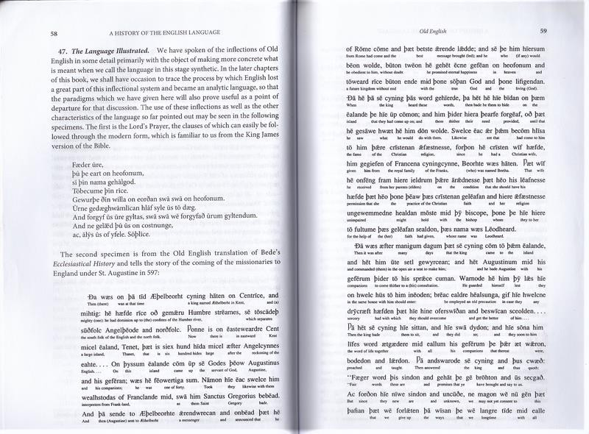
1. Periods of English Language

Slide 13
2. Relation between Language Families and Learning Costs

Slide 14
2. Relation between Language Families and Learning Costs
What Language Family Is
All existing languages in the world today can trace back to the specific original language.
The group of languages derived from the original one is called Language Family.

Slide 15
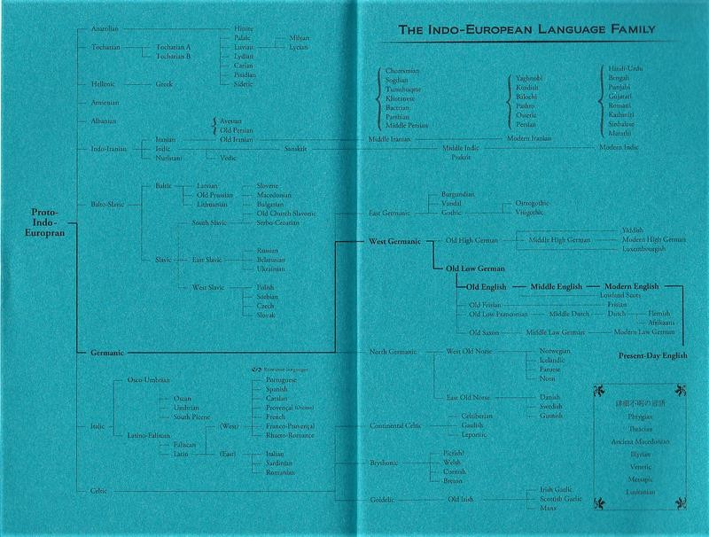
2. Relation between Language Families and Learning Costs

Slide 16
2. Relation between Language Families and Learning Costs
Germanic Languages
English
German
Dutch
Flemish
Danish
Swedish
Norwegian

Slide 17
2. Relation between Language Families and Learning Costs
Romantic Languages
Portuguese
Spanish
Catalan
Provencal
French

Slide 18
2. Relation between Language Families and Learning Costs
Celtic Languages
Welsh
Breton
Irish Gaelic
Scottish Gaelic

Slide 19
2. Relation between Language Families and Learning Costs
German Language vs. Japanese Language
Items to Compare | German Language | Japanese Language
Least Required Learning Hours | Approx. 480 hours | Approx. 2500 hours
Language Family | Germanic Language → Same as English Language | Unknown ※ Probably Altai Language
Grammatical Feature | Inflections → Changes of From based on Cases | Agglutination → Subjective to Particles
Affinity to Present-Day English | Proto-Indo-European Rooted | Natural Gender
Difference from the Present-Day English | Grammatical Genders and Infections | Grammatical Conjugations

Slide 20
2. Relation between Language Families and Learning Costs
That is to say…
Languages which belong to a different and far language family from yours are difficult to acquire.
→ It is very natural for Japanese learners of English languages to take a lot of pains.

Slide 21
3. Specific Features of Present-Day English

Slide 22
3. Specific Features of Present-Day English
Top 3 Pros
Features | Details | Notes
Rich Loan Words | Load words absorbed from languages all over the world provide rich expressions and solidarity to those who learn English as a foreign language. | Words whose root is either Latin or French account for over 50% of English vocabulary.
Loss of Grammatical Gender | Natural Gender → man is masculine, girl is feminine and all other words are neuters. The gender of the object agrees with the grammatical gender. | German has grammatical genders. [Masculine] sunne(sun) [Feminine] mond(moon) [Neuter] weib(wife)
Simplification of Grammatical Inflection | Proto-Indo-European had 8 cases which were nominative, genitive, dative, accusative, ablative, locative, instrumental and vocative. Present-Day English has only 2 cases: subjective and genitive. Finish has as many as 14 cases. | The genitive marker 's in Present-Day English is derived from the postfixes of genitive in Proto-Indo-European. It co-exists with of + noun today although the latter prevails.

Slide 23
3. Specific Features of Present-Day English
Top 2 Cons
Features | Details | Notes
Huge Difference Between Spellings and Pronunciation | It is too difficult to predict the accurate pronunciation from the spellings. e.g., name, foreign, archive, bouquet, draught, indict | ghoti is pronounced as /fɪʃ/, which is a famous joking. gh sounds same as enough(voiceless). o sound same as women(i-mutation). ti sounds the same as station(voiceless).
Too Many Idioms | Loss of inflection gave rise to development of propositions. They are combined with other classes such as proverbs and produces so many idioms, which are difficult to grammatically explain their structures. | Inflections in Old English were generous word orders; however, Present-Day English is strict on it after they were historically gone. e.g., "A dog bit a man." and "A man bit a dog." has the completely opposite relations between each subject and object.

Slide 24
3. Specific Features of Present-Day English
Other Features
Items | Values
The Number of Native English Speakers | Approx. 400 Millions
The Number of English Speakers as the second or foreign language | Approx. 1.2 billions
The Number of English-Speaking Countries and Regions | Approx. 30
The Share of English in the Field of Post | Approx. 75%
The Share of English in the Field of Technology | Approx. 80%
The Number of Words on The Oxford English Dictionary | Approx. 500,000 Words
The Number of Original Languages of Loan Words | Approx. 350 Languages
The Ration of English Vocabulary Latin and French Account For | More than 50%
The Duration of The History of English Language | Approx. 1500 years

Slide 25
4. Summary

Slide 26
4. Summary
English language has 4 periods.
English language and Japanese language have totally different roots each.
Present-Day English has representative 3 pros and 2 cons in the linguistic sense.

Slide 27
5. References

Slide 28
5. References
Albert C. Baugh and Thomas Cable, A HISTORY OF ENGLISH LANGAUGE sixth edition, London and New York, Routeledge, 2013
Kiyoaki Kikuchi・Kazutomo Karasawa・Ryuichi Hotta・Yasuyuki Kaizuka, 英語
史：現代英語の特質を求めて-多文化性と国際性-, Osaka, 関西人文科学出版会, 2009
Kiyoaki Kikuchi・Kazutomo Karasawa ・Takeshi Koike・ Ryuichi Hotta ・Kazuki Fukuda・ Yasuyuki Kaizuka ・Takeshi Matsuzaki, 英語学：現代英語をより深く知る ために-現代英語の諸相と英語学術語解説-, Osaka, 浪漫書房, 2008
Kazutomo Karasawa, 英語のルーツ, Kanagawa, 春風社, 2011

Slide 29
EOD

